Slide 1
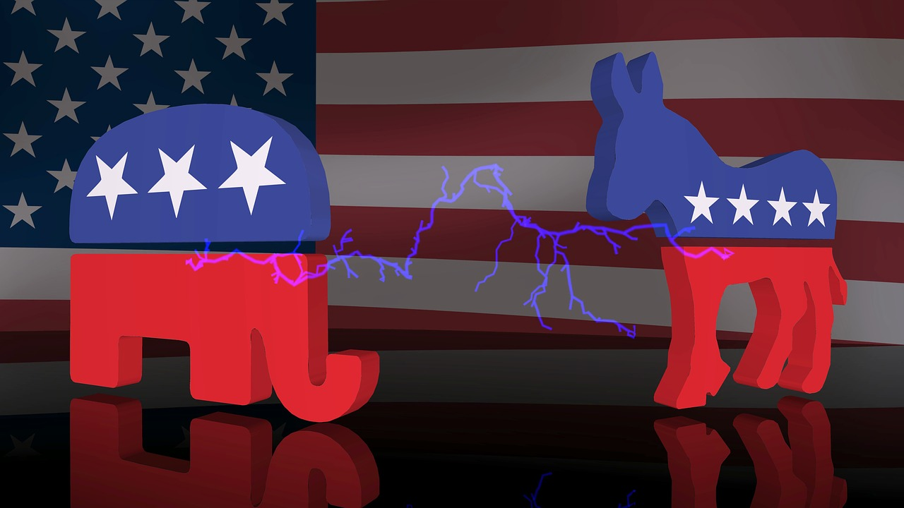
Can Political News Help Forecast Elections?
Joseph Schultz

Slide 2
Agenda
Introduction
Question
Methods
Results
Discussion

Slide 3
Introduction
First documented effort to forecast a political election was in 1503 with the papal election of Pope Pius III¹
Modern elections have focused on aggregating polls²
More recent efforts have focused on using historic results to generate regression models³, or to adjust polling data through multilevel regression with poststratification⁴ (MRP)
MRP has proven the most successful development with election forecasting in the last few years^{5, 6, 7}, but requires detailed information about poll respondents
Efforts have also been made to use social media to forecast elections⁸

Slide 4
United States Elections
Federal vs. State vs. Local
General Election vs. Primaries
Primary Election Calendar

Slide 5
Question
“Can political news data be used to help forecast political elections?”

Slide 6
Methods
All models constructed in RapidMiner v7.5
Election to be forecast is the US Democratic Primary Contests for Super Tuesday (Mar 03, 2020)
14 States will be forecast (AL, AR, CA, CO, MA, ME, MN, NC, OK, TN, TX, UT, VT, VA)
Ignoring American Samoa and Democrats Abroad contests
Primaries notoriously difficult to forecast due to smaller numbers of highly motivated voters and the dependence of individual State results on previous State results
4 States have contests before Super Tuesday (IA, NH, NV, SC)
SC has its Primary less than a week before Super Tuesday

Slide 7
Methods
Data Scrape & Prep
Three Models
Average Polling Model
Regression Model
Political News Model

Slide 8
Methods – Data Scrape & Prep
Scrape political websites
Political news websites chosen due to high traffic
https://www.politico.com/
https://www.foxnews.com/
https://www.realclearpolitics.com/
https://alltop.com/
https://www.msnbc.com/
https://www.cnn.com/politics
https://fivethirtyeight.com/politics/
https://www.washingtonpost.com/politics/?nid=top_nav_politics
https://www.latimes.com/politics
https://www.wsj.com/news/types/election-2020
https://www.nytimes.com/section/politics

Slide 9
Methods – Data Scrape & Prep
Scraped results were transformed with tokenization, stemming and removal of stop words into 5-grams
5-grams were then filtered so that only 5-grams with candidate names remained
Import sentiment from AFINN sentiment library

Slide 10
Methods – Average Polls Model
Take polls from fivethirtyeight⁹
All democratic primary polls for each State contest on Super Tuesday from Jan 01, 2020 through Mar 02, 2020 were averaged
Some State had very few polls, so necessary to include such a large date range

Slide 11
Methods – Regression Model
Fitted polynomial regression model generated for each State through a looping algorithm in RapidMiner using the polynomial regression operator
More robust approaches like MRP were not used due to a lack of polling detail typically required to implement MRP and related methods

Slide 12
Methods – Political News Model
5-grams were then broken apart into constituent words and word sentiment was imported using a sentiment library¹⁰
Aggregate sentiment & sentiment volume then imported for each candidate and run against polls with a Deep Learning Tanh algorithm

Slide 13
Results
Rendered in Tableau v2018.3
Descriptive – News Scrape Results
Mapping Forecasts
Comparing Models
Discussion
Candidate drop outs
Older polls favored Biden
Web scrape overperformed regression

Slide 14
References
Frederic J. Baumgartner. Behind Locked Doors: A History of Papal Elections. New York, Palgrave, 2003 (pages 88 and 250).
Alfred G. Cuzan, J. Scott Armstrong, and Randall Jones, "Combining Methods to Forecast the 2004 Presidential Election: The PollyVote" Archived 2013-01-23 at Archive.today
Rigdon, S., Jacobson, S.H., Cho, W.T., Sewell, E.C., Rigdon, C.J., 2009, “A Bayesian Prediction Model for the United States Presidential Election,” American Politics Research, 37(4), 700-724.
"What is MRP?". Survation.com. Survation. Retrieved 2 April 2020.
Jones, Amy (30 October 2019). "Lib Dems will stand aside for Dominic Grieve, as polling predicts a Boris Johnson majority". Daily Telegraph. Retrieved 2 April 2020.
Revell, Timothy (9 June 2017). "How YouGov's experimental poll correctly called the UK election". New Scientist. Retrieved 2 April 2020.
Cohen, Daniel (27 September 2019). "'I've never known voters be so promiscuous': the pollsters working to predict the next UK election". The Guardian. Retrieved 2 April 2020.
Cameron, Michael, Barrett, Patrick, Stewardson, Bob. (May 2013). “Can Social Media Predict Election Results? Evidence from New Zealand. Journal of Political Marketing. Retrieved Apr 2, 2020.
Fivethirtyeight. Available: https://projects.fivethirtyeight.com/polls/president-primary-d/. Retrieved Mar 04, 2020.
AFINN Library. Available: https://github.com/fnielsen/afinn/tree/master/afinn/data. Retrieved Feb 17, 2020.

Slide 15
Review
Introduction
Question
Methods
Results
Discussion

Slide 16
Thank you!

